Slide 1
Ask Weber
Session 4: 15-05-2020
Contents:
L9, 10, 13, 14, 15, 16
Weber Liu

Slide 2
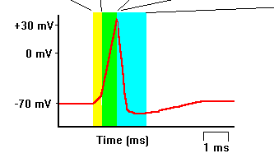
Lecture 9: Talking cells
In the following figure, for each colour, describe what happens to the sodium and potassium ion channels

Slide 3
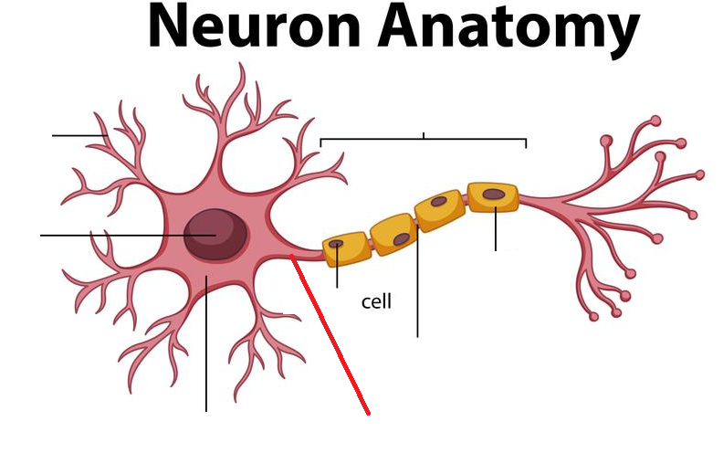
Lecture 9: Talking cells
Label the following components of a neuron:

Slide 4
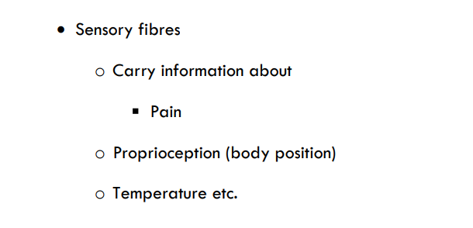
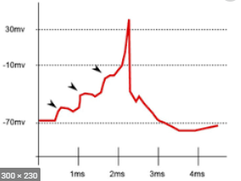
Lecture 9: Talking cells
What modalities do sensory nerve fibres carry?
Which modalities are conducted fastest?
What cells are responsible for the formation of the nodes of Ranvier?
describe the process of neurotransmission across the synaptic cleft
Ethanol (Alcohol) as well as benzodiazepines are substances which potentiate the action of GABAergic neurotransmission (they act on GABA receptors on the post-synaptic cleft). In doing this, the function of GABA is increased. Would this result in the post-synaptic neurone firing more or less often?

Slide 5
Lecture 9: Talking cells
In computer science (machine learning), the deep neural network is a concept which involves computational and mathematical representation of neurons. In these networks, multiple ‘neurons’ will ‘fire’ onto a single ‘neuron’. When ‘firing’, they will give the target neuron a value between -1 and 1. For example:
if neurons A1, A2, A3 fire onto neuron B1, all they are doing is giving neuron B1 a number between -1 and 1 (e.g. -0.1, 0.3, 0.5).
Neuron B1 will take the average of the three values firing onto it (in this case, the average of -0.1, 0.3 and 0.5 is 0.35).
If the average of neuron B1 is > 0, it will pass on its value onto the next neuron in the chain. If it is <0, it will not pass on any value at all.
In the example of the neural network above:
Which neuron would be considered a ‘GABAergic’ neuron?
How does this model demonstrate a certain type of EPSP summation?
How does this model demonstrate the idea of the threshold potential?

Slide 6
Lecture 9: Talking cells
In myasthenia gravis, (autoimmune) antibodies target the nicotinic acetylcholine receptors at the neuromuscular junction (where the neuron triggers the muscle unit to activate). In this process, antibodies will destroy these post-synaptic neurotransmitters. What symptom/sign would you expect to see in the patient with MG?
Where does the CNS end and the PNS begin? Which sensory nerve fibres are considered part of the CNS, and which are part of the PNS?
What makes white matter ‘white’?

Slide 7
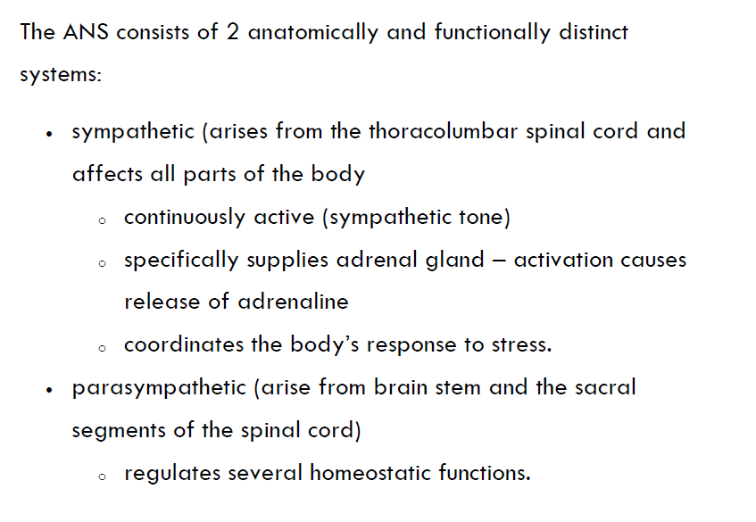
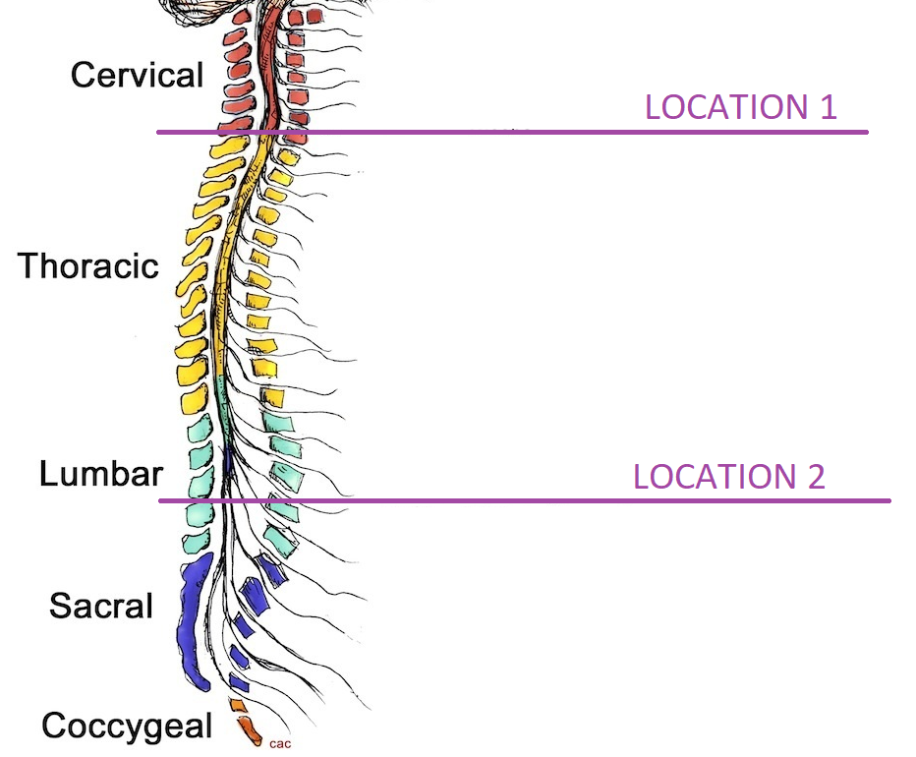
Lecture 9: Talking cells
Take the following figure
If the spinal cord were severed at location 1, would the sympathetic or parasympathetic system be affected more? Why?
If the spinal cord were severed at location 2, would the sympathetic or parasympathetic system be affected more? Why?

Slide 8
Lecture 9: Talking cells
A psychiatric anxiety disorder known as ‘performance anxiety’ (a subtype of social anxiety) causes an individual suffering from this disorder to experience extreme anxiety attacks when performing in public places or public speaking. This has dramatic effects on their capacity to function in the workplace, as they cannot give presentations or talk in front of large groups of people. One of the first line therapies for this is a beta adrenergic receptor blocker (propranolol).
What is the action of a beta agonist receptor blocker?
What is its effect on the cardiovascular system?
Why is propranolol generally contraindicated for severe asthmatics?

Slide 9
Lecture 13
What is the primary function of the gall bladder?
List the 3 pairs of salivary glands in the oral cavity
T/F: Amylase, found in the mucous component of saliva, is important for the enzymatic breakdown of carbohydrates into simpler sugars
Your gastrointestinal system pushes a food bolus through itself through the process of peristaltic contractions. What is the first major organ where peristalsis occurs?
Name the 2 sphincters found on the stomach

Slide 10
L13
With regards to pepsin
In what form is it produced in the human body
Which cells (and where are these cells) produce the pepsin precursor
How is pepsin activated
What cells are responsible for the activation of pepsin?

Slide 11
L13
Pernicious anaemia (anaemia = low red blood cell count) is an autoimmune disorder (auto = self, immune = immune system; autoimmune = self-harming immune disorder) which results in a megaloblastic anaemia (a form of anaemia where the red blood cells are large). This form of anaemia occurs primary due to a deficiency in folate, or a deficiency of vitamin B-12.
Joanne is a 33 year old female who presents to her GP with signs of fatigue and weakness (non-specific signs of anaemia). Her red cell count and smears showed a megaloblastic anaemia. Her folate levels were normal, but her VB12 levels were reduced. The mechanism of low VB12 is a deficiency in a substance produced in the stomach which hells bind and digest VB12. What is this substance that Joanne is missing?

Slide 12
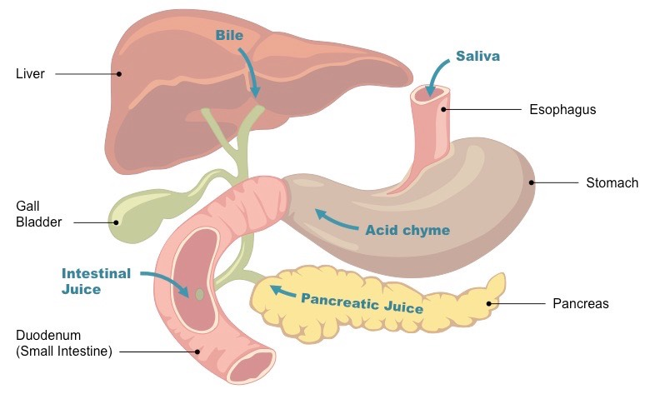
L13
Toxic megacolon is a disorder which occurs due to bacterial overgrowth within the gastrointestinal tract. This can result in severe sepsis and eventually death if undetected. It can occur in babies who are congenitally born with a disorder known as ‘Hirschsprung disease’ where there is a failure of migration of the enteric nervous system (i.e. the nerves which control gut movement/motility). These nerves must migrate to their segment of the alimentary canal within the foetus, and will migrate orally to anally.
In order, list the major organs of the alimentary canal.
Given that Hirschsprung disease affects the organ before the anus, predict which organ is lacking innervation in this disease.
Large intestine
Identify the process which is responsible for gastrointestinal motility.
peristalsis

Slide 13
L14
The use of ATP for energy is an example of catabolism/anabolism
Describe the process of the electron transport chain and the interaction of each of the mitochondrial complexes
What outputs from the citric acid cycle are necessary for the function of the electron transport chain

Slide 14
L15
Addison’s disease is a autoimmune disorder resulting in the destruction and thus reduced function of the adrenal glands.
Which hormone is produced by the adrenal glands and plays a role in kidney function
What does this hormone do in the kidney, and where
In Addison’s disease, would you expect the patient to become hyper or hypotensive

Slide 15
L15
SIADH is disorder which can present after head injury (including surgeries close to the brainstem). This disorder (Syndrome of Inappropriate ADH) results in excessive ADH secretion and increased function of ADH
Why will this result in a bilateral pitting oedema
Where does ADH act, and what is its function physiologically?

Slide 16
L15
Diabetes insipidus is a disorder caused by a reduced function or secretion of ADH. A patient presents to their GP complaining of excess thirst (polydipsia) and excess urination (polyuria) – both signs of Diabetes. His blood sugars were normal however a diagnosis of diabetes insipidus was made. A special test which measures serum ADH levels showed level of ADH.
If Diabetes insipidus is caused by a reduced function of ADH, yet the patient’s ADH levels were still high, where would the origin of the issue be?

Slide 17
L16
Budd-Chiari syndrome is a disorder where the hepatic vein (output) become thrombosed (i.e. a clot forms and stops blood flow).
Where does the liver get its blood from?
In the pathophysiology of budd-chiari syndrome, hepatic congestion occurs (i.e. it overloads with fluid). Describe why this would happen

